Slide 1

MAS SaaS Sales Update 4 Aug 2023 Rod Reicks Product Manager, MAS SaaS Mike Cookson Product Manager, MAS Dedicated
IBM Sustainability Software
© 2023 IBM Corporation

Slide 2

Please Note
IBM’s statements regarding its plans, directions, and intent are subject to change or withdrawal without notice at IBM’s sole discretion. Information regarding potential future products is intended to outline our general product direction and it should not be relied on in making a purchasing decision.
The information mentioned regarding potential future products is not a commitment, promise, or legal obligation to deliver any material, code or functionality. Information about potential future products may not be incorporated into any contract.
The development, release, and timing of any future features or functionality described for our products remains at our sole discretion.

Slide 3
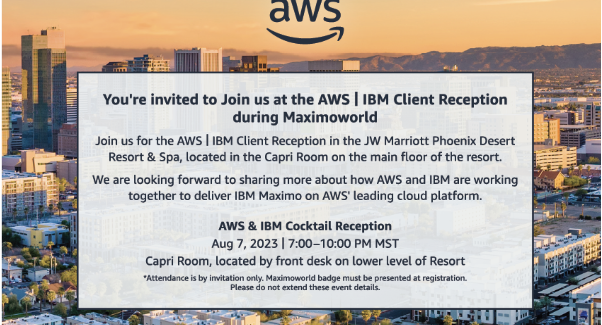
Send an email to neeraj.nargund@ibm.com if you plan to attend

Slide 4
Agenda
Introduction
Learning Objectives
MAS Deployment Options
Part one: MAS SaaS Packages
Introduction to tiered packages
MAS SaaS tiering
Selecting the best tier for your client
MAS SaaS service comparisons
Part two: AWS Marketplace Update
EMEA AWS Marketplace expansion
AWS Marketplace tiering transition
Questions

Slide 5

Learning Objectives
Preview forthcoming MAS SaaS announcements
Understand packaged pricing structures
Understand MAS SaaS tiers & the contents of each
Understand current options to purchase MAS SaaS via the AWS Marketplace
Understand AWS Marketplace expansion plans
Please note, this is not a client facing deck. Material that can be shared with clients is under development and will be made available over the next month.

Slide 6
MAS Deployment Options
Deployment | Availability | Procure | Provision & Operate | Client Benefits
On Premise Customer Managed | Now | Client purchases MAS from IBM Client provides infrastructure | Client provisions, manages, and operates full stack | Maximum operational flexibility
Hyperscalers Customer Managed | Now AWS 1Q22 Azure 2Q22 | BYOL Client purchases software from IBM and infrastructure from Hyperscalers | Client runs IBM-provided automation scripts to deploy MAS on Hyperscalers’ cloud Client manages and operates both software and infrastructure | Simplifies procurement and deployment Allows client to select their Hyperscalers Flexibility for clients to manage and operate their environment
 | Now AWS 3Q22 Azure 4Q22 | Paid (Marketplace listing) Client purchases software and infrastructure from Hyperscalers
SaaS IBM Managed | Now AWS 3Q22 | Client purchase single part (includes software, infrastructure, and operations) from either std IBM sales/channels or AWS Marketplace | IBM provisions, manages, and operates Client’s MAS environment on AWS Cloud using IBM’s AWS cloud account | Reduced time-to-value Reduced operational costs Allows clients to focus on business priorities
Dedicated (formerly Managed Service) IBM Managed | Now IBM 2020 AWS 2023 | Client purchases software and managed service (including infrastructure) from IBM | IBM provisions, manages, and operates Client’s MAS environment on IBM Cloud or AWS in an IBM owned account Currently has two flavors Shared cluster (legacy – IBM Cloud only) Dedicated cluster (new) | Simplifies deployment and operations Provides more flexibility, than SaaS, to customize environment Provides more operational flexibility than SaaS

Slide 7

MAS SaaS Packages

Slide 8
New Focus on MAS SaaS
Description
Value
ESSENTIALS
Easy to acquire & simple to adopt
Key EAM and Mobile features
Fixed configurations at an attractive price point
Reduced time-to-value
Reduced operational costs
Allows clients to focus on business priorities
Essentials + incremental features
Solid foundation of features / usage that serves a broad range of capabilities
Standardized configurations at a moderate price
STANDARD
Further simplifies deployment and operations
Provides more flexibility than Essentials and Standard to customize environment
Provides more operational flexibility than SaaS
PREMIUM
Standard + incremental features
Enterprise offering with strong differentiation
Highly configurable options
Notes:
Enterprise security and quality consistently available; standard across all three tiers
Support - Basic Support provided across all three tiers; Enhanced Support is available for all offerings & should be proposed with all Premium Offerings.

Slide 9
MAS SaaS Packages
Essentials
Maximo Maintenance Essentials
Manage + Mobile + Health
Maximo Inspection Essentials
Visual Inspection
Entry level offering for new SaaS clients
Starting at less than $40K per year
Fixed configurations at a fixed price
Minimum operational flexibility
Suitable for small on-premises EAM clients
1 environment
Up to 25 users
Up to 100 work orders / hour
Up to 1,000 health scores / hour
Scheduler included
Add’l purchase options
Max of 1 add’l environment
1 GPU
Up to 2 deployed models
Up to 5 edge devices
Up to 10K inferences / hour
Up to 100 GB storage
Add’l purchase options
None
OR
Standard
Full MAS Suite with Standard Operational Practices
Current MAS SaaS offering
Starting at less than $75K per year
Select additional purchase options available
Limited operational flexibility
Best option for most SaaS Flex clients
Select from any MAS module or combination of modules
Purchase multiple non-production environments; R/W access to non-prod environments is included
Purchase any capacity of functionality (e.g., Users, Scores/Inferences, I/O Points, etc.)
Select from preferred AWS data centers (US-East, Montreal, Frankfurt or Sydney)
All Manage Industry Solutions & Add-ons are available; some may require additional AppPoints
Add’l purchase options²
Non-production environments • Optimizer
Read-only production DB replica • Allow Listing
Premium
Full MAS Suite with Custom Operational Options²
Advanced options for clients with specific requirements
Starting at less than $150K per year¹
Wide selection of advanced purchase options²
Broad operational flexibility options²
Tailored configurations for complex deployments
Flexible scheduling of updates & upgrades (within limits & excluding certain security items)
Support for multiple VPNs
Deployment validations for regulated industries
Dedicated personnel
Add’l purchase options²
Extended update/upgrade schedules • Reduced RPO/RTO • Oracle or SQL Server database
Extended data retention periods • Direct (Private) Connect • Choice of any AWS data center
Multi-site / Multi-zone support • Multi-Workspaces that offers necessary services
¹ Subject to change
² Availability of options will vary. Not all will be available at initial release.

Slide 10
Same parts Same channels Same ordering process
1
2
3
Identify the best tier
Determine capacity
Calculate AppPoints

Slide 11
MAS SaaS AppPoints Requirements¹
Essentials – 150 AppPts
Standard – 300 AppPts
Premium – 500 AppPts
Base Configuration
Maintenance Essentials
Base Configuration
Manage
Base Configuration
Manage
100 Base Install AppPoints
100 Base Install AppPoints
100 Base Install AppPoints
Transition to a higher tier by purchasing additional AppPoints
No migration required
0 Application Install AppPoints
150 Application Install AppPoints
350 Application Install AppPoints
50 User AppPoints
Add’l Options
Maintenance Essentials
50 User AppPoints (Minimum)
1 Add’l Environment: 50 AppPoints
Add’l Options
Manage
50 User AppPoints (Minimum)
Each Add’l Non-Production Environment: 70 AppPoints
Add’l Options
Manage
Production Database Replica: 50 AppPoints
Optimizer: 50 AppPoints
Each Add’l Non-Production Environment: 120 AppPoints
Allow Listing: 50 AppPoints²
Production Database Replica: 85 AppPoints
Reduced RPO / RTO: TBD AppPoints
Extended Data Retention Periods: TBD AppPoints
¹ Subject to change
² Availability of options will vary. Not all will be available at initial release.

Slide 12
MAS SaaS Part Structure
PID 5900-AMG: IBM Maximo Application Suite as a Service
Required Parts
D0A51ZX: IBM Maximo Application Suite as a Service for Other Public Clouds AppPoint
D0A52ZX: IBM Maximo Application Suite as a Service for Other Public Clouds AppPoint Overage
D0A50ZX: IBM Maximo Application Suite as a Service for Other Public Clouds Service Level Agreement
Optional Part
D0D5BZX: IBM Maximo Application Suite Migration Service Resource Unit Set Up
Additional Options
E0ECPZX: IBM Maximo Application Suite as a Service for Other Public Clouds AppPoint Advanced Support
Future: Expert Labs migration assistance

Slide 13
Which Tier is the Right Fit?
Does client require an application other than Manage or MVI?
Does client’s projected usage exceed capacity limits?
Does client have specific provisioning requirements?
Does client have specific integration requirements?
Does client require validation time for updates or upgrades?
MAS SaaS Essentials
No
No
No
No
No
Yes
Yes
Yes
Yes
Yes
Does client require a data center other than a preferred location?
Does client require a specific database?
Does client require advanced networking options?
Does client have specific RPO/RTO or data retention requirements?
Does client require flexible or extended update / upgrade schedules?
MAS SaaS Standard
No
No
No
No
No
Yes
Yes
Yes
Yes
Yes
MAS SaaS Premium

Slide 14
MAS SaaS Service Comparison^{1,2}
Feature | Essentials | Standard | Premium
Purchasing
Software | ◼︎³ | ◼︎ | ◼︎
Infrastructure | ◼︎ | ◼︎ | ◼︎
Non-production Environments | ◻︎⁴ | ◻︎ | ◻︎
Provisioning
Cloud Provider | AWS | AWS | AWS
Choice of Data Center | — | From Preferred List | ◻︎⁵
Choice of Database | — | — | ◻︎ / ▷
Production Database Access | — | ◻︎⁶ | ◻︎⁶
Non-production Database Access | ◼︎⁷ | ◼︎⁷ | ◼︎⁷
Add-ons & Industry Solutions | Limited | ◼︎ / ◻︎ | ◼︎ / ◻︎
VPN Connectivity to Client | ◼︎ | ◼︎ | ◼︎
Network Connection Options (Allow Listing) | — | ▷︎ | ►
Multiple VPNs | — | — | ◼︎
Direct Connect | — | — | ▷
Bare Metal Servers | — | — | ▷
Capabilities
Scheduler Optimizer | — | ◻︎ | ◼︎
Cognos SaaS | — | — | ▷
Multiple Workspaces | — | — | ▷
Included ◼︎
Additional Purchase ◻︎
Future Included ►
Future Add’l Purchase ▷
Not Available —
¹ Subject to change
² Availability of features will vary. Not all will be available at initial release.
³ One application only
⁴ Maximum of one
⁵ Data center must support services required by MAS SaaS
⁶ Read-only via replica
⁷ Read/Write

Slide 15
MAS SaaS Service Comparison^{1,2}
Feature | Essentials | Standard | Premium
Integration
SAP & Oracle Adaptors | — | ◼︎ | ◼︎
AppConnect SaaS | — | ▷ | ►
Integration via MIF | ◼︎ | ◼︎ | ◼︎
Automation Scripting via MaxAdmin user | ◼︎ | ◼︎ | ◼︎
Certified Third-party Java / Python code | — | — | ▷
Security Integrations (SIEM Support) | — | — | ▷
Operations
Self-Service Portal | ◼︎ | ◼︎ | ◼︎
ISO 27001 & SOC2 Compliance | ISO 27001 ◼︎ / SOC2 ︎► | ISO 27001 ◼︎ / SOC2 ︎► | ISO 27001 ◼︎ / SOC 2 ►︎
Update & Upgrade Scheduling | Fixed | Standard⁸ | Flexibile⁹ ◼︎ / Extended¹⁰ ◻︎
SLA | High Availability | High Availability | High Availability
Disaster Recovery | Standard | Standard | Reduced RPO / RTO ▷
Multi-Site Support | — | — | ▷
Multi-Zone Support | — | — | ▷
Point-in-time Application Recovery | — | — | ▷
Extended Data Retention | — | — | ▷
Dedicated Personnel | — | — | ◼︎
Regional Exclusions | — | — | ▷
Customized terms (SOW) | — | — | —
Included ◼︎
Additional Purchase ◻︎
Future Included ►
Future Add’l Purchase ▷
Not Available —
¹ Subject to change
² Availability of features will vary. Not all will be available at initial release.
⁸ Non-prod first, followed 30 days later by Production
⁹ Up to 6 months, excluding security items
¹⁰ Greater than 6 months & LTS available, excluding security items

Slide 16



Timeline
Start now!
Announce & Discuss
Week of Aug. 7 at MaximoWorld
Inform clients about next generation trial
Unveil MAS SaaS tiered packages
Gather client requirements
Explore the right fit
Prepare for quoting
Initiate Quotes
Sept. 1
New AppPoints calculator
Build quotes in SQO & obtain quote approvals
Sell
Oct. 1
Accept orders
Revised AWS Marketplace listings go live in 5 countries
Client Provisioning
November 2023
Tiered package deployments to be based on MAS 8.11 release
Availability subject to validation by SRE team

Slide 17

AWS Marketplace

Slide 18
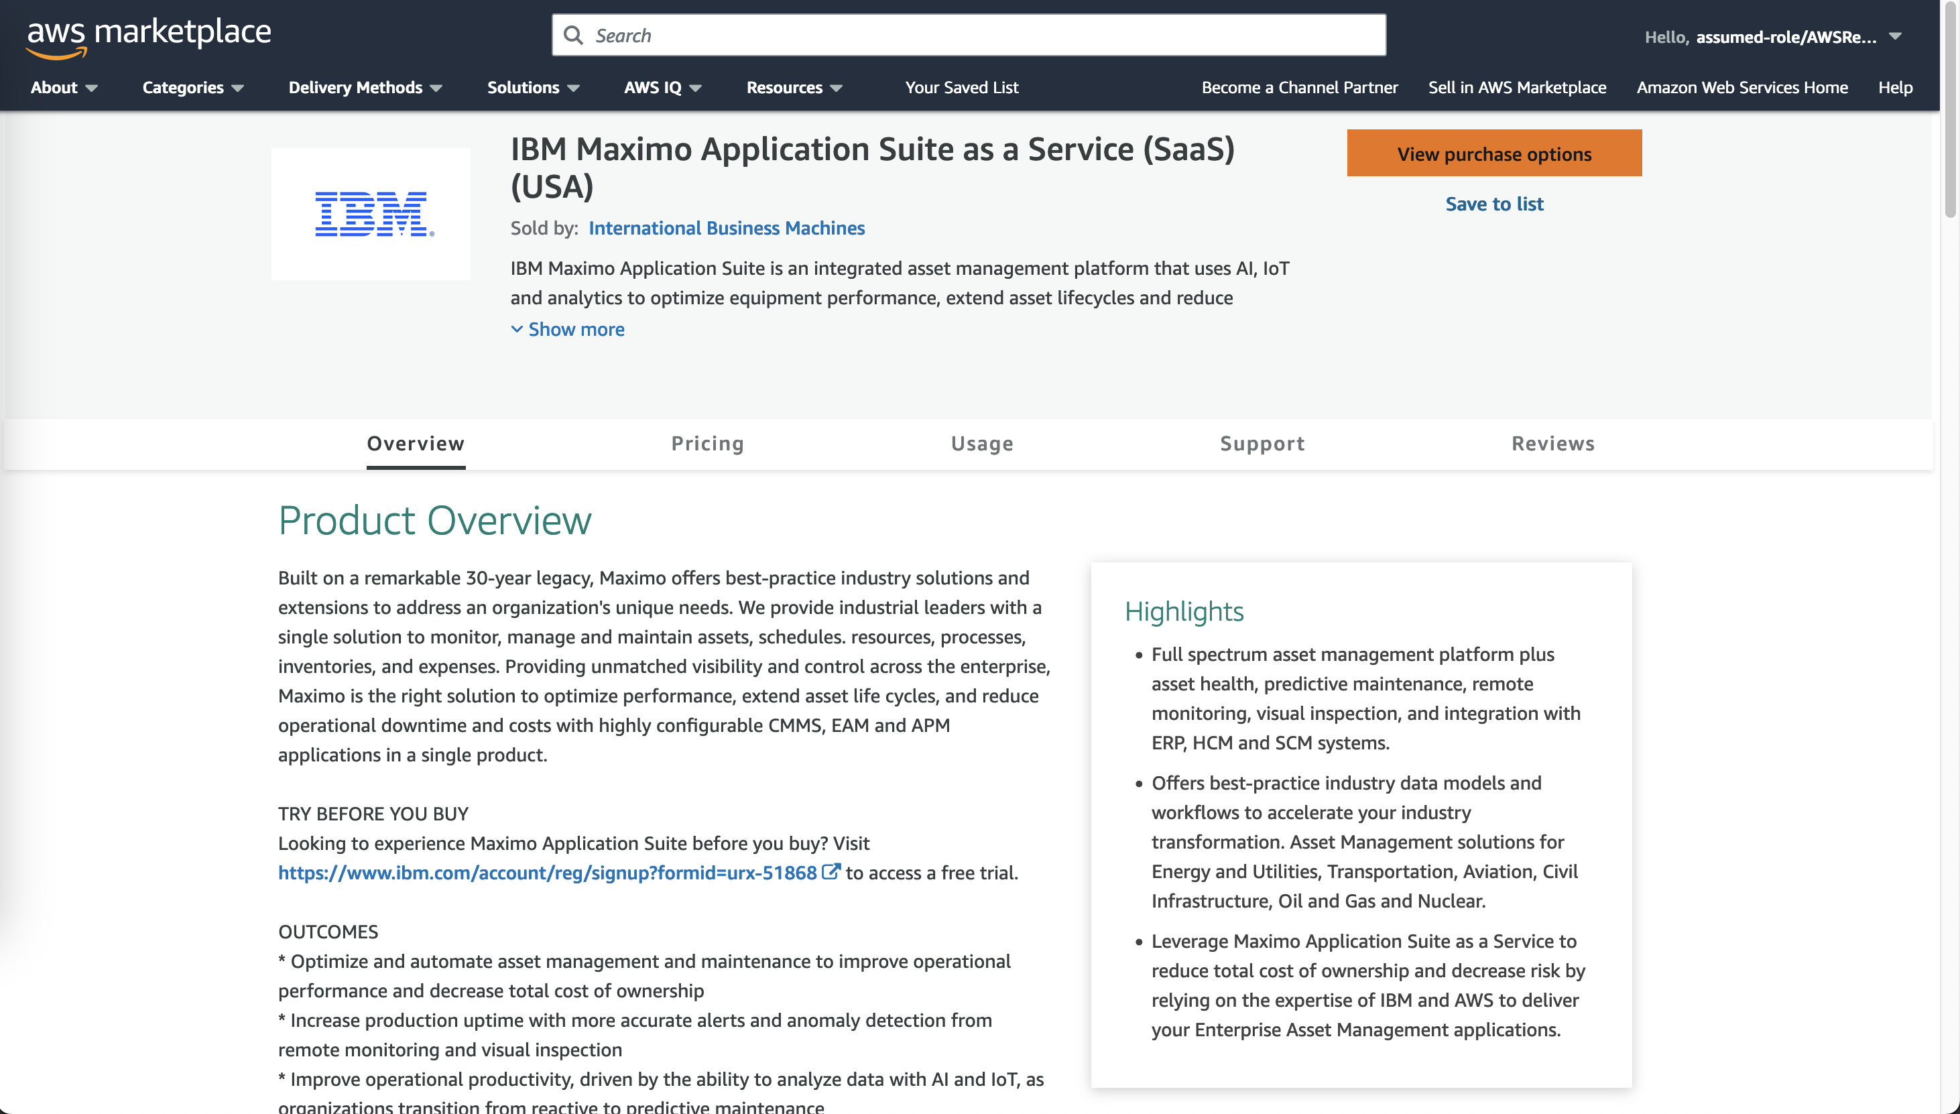
AWS Marketplace Review
Public Offer
Fixed configuration & price
Self-service purchase
No seller involved
No additional discounts
Private Offer
Flexible configurations
Seller guided
SQO quote
Discounts allowed
IBM sellers are compensated on both
Partners can transact Private Offers in the US

Slide 19

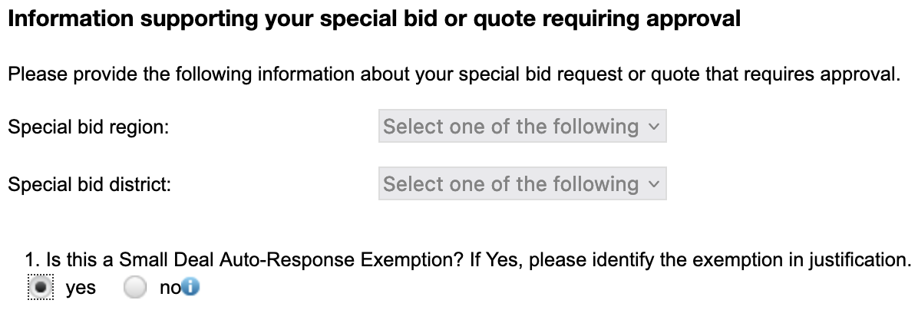
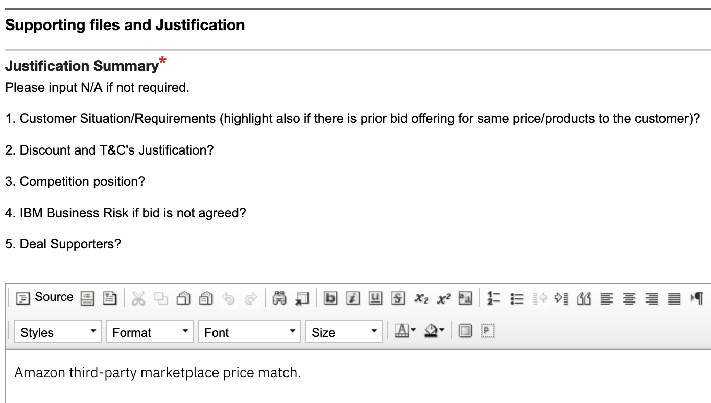
AWS Marketplace Package Transition
Option I: Maximo Maintenance Essentials
Will replace existing AWS Marketplace listings for Manage
Manage + Health + Mobile
Less than $40K entry level price (150 AppPoints)
Option to add 1 environment
Option II: Maximo Inspection Essentials
New AWS Marketplace listing for MVI
MVI with 1 GPU & up to 10K inferences per hour capacity
Less than $40K entry level price (150 AppPoints)
Planned go-live is Oct. 1
Eligible for Client’s EDP drawdown

Slide 20
Resources
Key MAS SaaS Resources
MAS Trial Site | https://auth.sandbox-trial.suite.maximo.com/login/
MAS on Hyperscalers Seismic Landing Page | https://ibm.seismic.com/Link/Content/DCdP9fqcWpPdMG9HQWCQ7cDm8DqB
MAS SaaS Documentation | https://cloud.ibm.com/docs/mas-saas
MAS SaaS AppPoints & Migration Calculator | https://ibm.seismic.com/Link/Content/DCWDpXGfP636BGhX3pTbVQQFh388
Migration from Maximo EAM to MAS SaaS or MAS Dedicated | https://ibm.seismic.com/Link/Content/DCBPCqq9DGPC98HMV2cVhgWd2Qfd
MAS SaaS Announcement Letter | https://www.ibm.com/common/ssi/ShowDoc.wss?docURL=/common/ssi/rep_ca/6/897/ENUS222-016/index.html
MAS on Hyperscalers L1 Presentation | https://ibm.seismic.com/Link/Content/DCgBRVRmQGVV3G2VR7TmPXDJpjW8
MAS SaaS Technical Enablement | https://ibm.seismic.com/Link/Content/DCP9JjV3mpVXRGW2WgjMDV7pcRJP
MAS SaaS on AWS Marketplace URL | https://aws.amazon.com/marketplace/pp/prodview-v3sr4a3tzxuqk?sr=0-15&ref_=beagle&applicationId=AWSMPContessa

Slide 21


